Slide 1



Slide 2
DC presents
Capstone Project: Part 2
UFO Sightings
Problem
UFO sightings have been reported globally for decades, sparking curiosity and debate among scientists, enthusiasts, and the general public. However, there is limited systematic analysis of the data to understand:
Temporal patterns - Are there specific time periods or years with increased sightings?
Geographic Distribution - Are certain regions or countries more prone to UFO sightings?
Goal
This project aims to systematically investigate and analyze UFO sighting data to identify patterns, trends, and anomalies across temporal and geographic dimensions.
Furthermore, to address key questions by employing data analytics methodologies to extract meaningful insights and offer a data-driven perspective on the phenomenon of UFO sightings.
Criteria for Success
Success will be determined by the effective wrangling of data from reliable sources, ensuring key variables are utilized to generate meaningful insights. This includes developing a predictive model (time series) to identify locations with the highest probability of UFO sightings, model achieving a low AIC score.
The project will culminate in a professional presentation tailored to a general audience, clearly communicating findings and their significance.

Slide 3
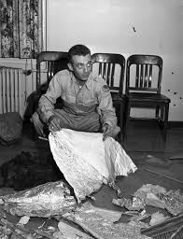


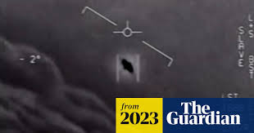
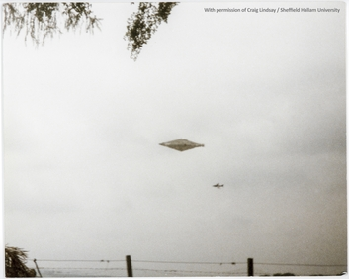
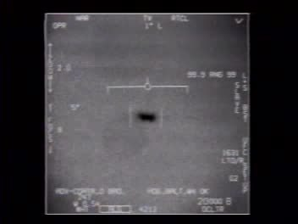
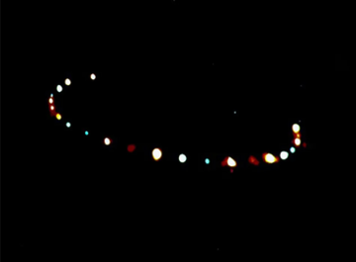
Capstone Project: Part 2
UFO Sightings
Problem
UFO sightings have been reported globally for decades, sparking curiosity and debate among scientists, enthusiasts, and the general public. However, there is limited systematic analysis of the data to understand:
Temporal patterns - Are there specific time periods or years with increased sightings?
Geographic Distribution - Are certain regions or countries more prone to UFO sightings?
1947 Roswell Incident
more
2023, AARO releases footage of UAPs captured by military
1561, celestial phenomenon over Nuremburg, Germany
1566, celestial phenomenon over Basel, Switzerland
1990 Calvine UFO
2004, USS Nimitz UFO Incident
1984 Hudson Valley UFO Sightings
Goal
This project aims to systematically investigate and analyze UFO sighting data to identify patterns, trends, and anomalies across temporal and geographic dimensions.
Furthermore, to address key questions by employing data analytics methodologies to extract meaningful insights and offer a data-driven perspective on the phenomenon of UFO sightings.
Criteria for Success
Success will be determined by the effective wrangling of data from reliable sources, ensuring key variables are utilized to generate meaningful insights. This includes developing a predictive model (time series) to identify locations with the highest probability of UFO sightings, model achieving a low AIC score.
The project will culminate in a professional presentation tailored to a general audience, clearly communicating findings and their significance.

Slide 4

Capstone Project: Part 2
UFO Sightings
Problem
UFO sightings have been reported globally for decades, sparking curiosity and debate among scientists, enthusiasts, and the general public. However, there is limited systematic analysis of the data to understand:
Temporal patterns - Are there specific time periods or years with increased sightings?
Geographic Distribution - Are certain regions or countries more prone to UFO sightings?
Goal
This project aims to systematically investigate and analyze UFO sighting data to identify patterns, trends, and anomalies across temporal and geographic dimensions.
Furthermore, to address key questions by employing data analytics methodologies to extract meaningful insights and offer a data-driven perspective on the phenomenon of UFO sightings.
Criteria for Success
Success will be determined by the effective wrangling of data from reliable sources, ensuring key variables are utilized to generate meaningful insights. This includes developing a predictive model (time series) to identify locations with the highest probability of UFO sightings, model achieving a low AIC score.
The project will culminate in a professional presentation tailored to a general audience, clearly communicating findings and their significance.

Slide 5
Capstone Project: Part 2
UFO Sightings
Problem
UFO sightings have been reported globally for decades, sparking curiosity and debate among scientists, enthusiasts, and the general public. However, there is limited systematic analysis of the data to understand:
Temporal patterns - Are there specific time periods or years with increased sightings?
Geographic Distribution - Are certain regions or countries more prone to UFO sightings?
Goal
This project aims to systematically investigate and analyze UFO sighting data to identify patterns, trends, and anomalies across temporal and geographic dimensions.
Furthermore, to address key questions by employing data analytics methodologies to extract meaningful insights and offer a data-driven perspective on the phenomenon of UFO sightings.
Criteria for Success
Success will be determined by the effective wrangling of data from reliable sources, ensuring key variables are utilized to generate meaningful insights. This includes developing a predictive model (time series) to identify locations with the highest probability of UFO sightings, model achieving a low AIC score.
The project will culminate in a professional presentation tailored to a general audience, clearly communicating findings and their significance.

Slide 6


Capstone Project: Part 2
UFO Sightings
Potential Audience
Dr. Jon Martinez, Astrophysicist
This target persona represents a highly technical, research-driven astrophysicist who would benefit from the UFO sightings capstone project’s insights, making them an ideal audience for the final deliverables.
"The universe is full of mysteries. By analyzing UFO sightings scientifically, we can separate the explainable from the extraordinary and push the boundaries of our understanding."
Mia Thompson, UFO Enthusiast
This target persona represents a passionate, non-technical UFO enthusiast who would benefit from the UFO sightings capstone project’s insights, making her an ideal audience for engaging and accessible deliverables.
"The truth is out there, and I want to help people see it. By combining data with storytelling, we can uncover the mysteries of the skies together."

Slide 7
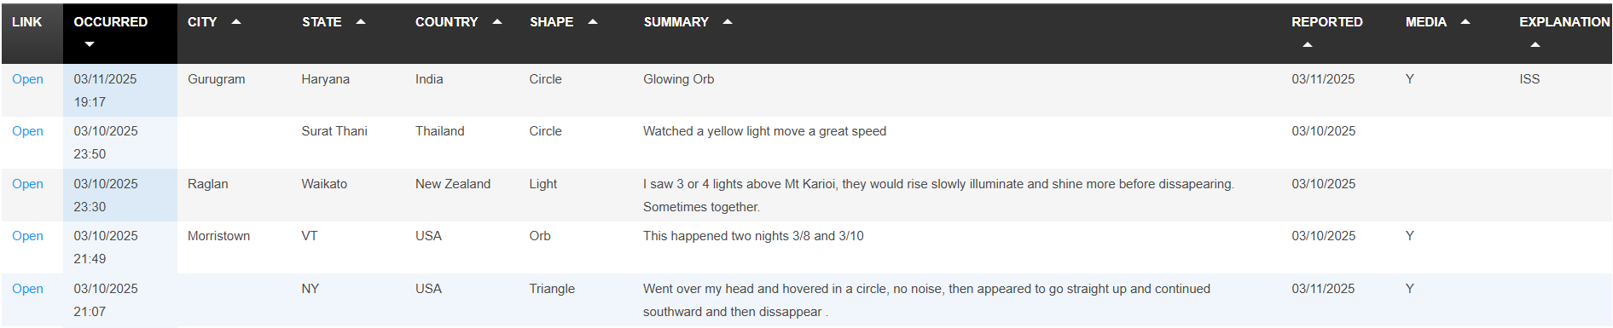

Capstone Project: Part 2
UFO Sightings
Datasets
Dataset from NUFORC website (https://nuforc.org/) , alternatively cleaned extract(outdated) can be found on Kaggle.
Data Scope: ~150k records in NUFROC database, ~89k records in Kaggle dataset
NUFORC database contains an additional useful column “Explanation”, which attempts to identify the UFO.
Kaggle dataset last updated 5 years ago and hence omits recent years sightings.

Slide 8
Capstone Project: Part 2
UFO Sightings
Planned Approach
Data Source & Cleanup
Either NUFORC or Kaggle datasets in .csv format
Formatting and EDA in Python or Excel or Power BI
Data Analysis & Charts
Export to Excel or Power BI
Narrow down to country with highest number of sightings, further deep-dive by states/locations
Predictive Model
Time Series (ARIMA)
Y-axis = Number of Sightings per month in focused country

Slide 9
Thank You

